Slide 1
Super Resolution
Team 10:
Chetanye Maheshwari
Eddie Steiner
Khairul Islam
Steven Subianto
Notes:
Khai

Slide 2
Introduction
SRCNN: Super Resolution Convolutional Neural Network
Dataset: DIV2K
Objective: To develop a deep learning-based solution to enhance low-resolution images to higher resolution, using an SRCNN-like architecture trained on DIV2K dataset
Key Steps:
Data Preparation
Model Architecture
Training
Evaluation Metrics
Notes:
Khai

Slide 3
Dataset
DIV2K
https://data.vision.ee.ethz.ch/cvl/DIV2K/
1,000 images
800 training
100 validation
100 test
https://www.kaggle.com/datasets/soumikrakshit/div2k-high-resolution-images
900 images
800 training
100 validation
Notes:
Khai

Slide 4
Data Preparation
Utilized DIV2K dataset containing high-resolution images
Created low resolution counterparts by downsampling high resolution images to simulate real world image degradation.
Extracted patches from both high resolution and low resolution images to increase training efficiency.
Notes:
Steven

Slide 5
Model Architecture
Developed an SRCNN model with modification to assist with performance
Utilized a combination of both ReLU and Sigmoid activation functions:
ReLU: used in intermediate layers to introduce non-linearity and enable model to learn complex mappings
Sigmoid: used in specific layers to help normalize outputs within a specific range
Utilized convolution layers to extract hierarchical features:
Larger filters in initial layers to capture broad features
Smaller filters in subsequent layers to refine the details
Incorporated residual connections to improve gradient flow and training stability
Notes:
Edd

Slide 6
Training
Compiled the model with a Mean Squared Error (MSE) loss function, which ensures pixel-level accuracy to minimize differences between low and high-resolution images.
Employed an Adam optimizer with a learning rate scheduler to adjust the learning rate as training progresses.
Integrated early stopping to prevent overfitting when validation loss plateaus
Notes:
Edd

Slide 7
Evaluation Metrics
Used Mean Squared Error (MSE) as the primary evaluation metric to monitor training and validation error trends. MSE helps ensure pixel-level accuracy by measuring the average squared difference between predicted and true pixel values.
Assessed quality improvements by visually comparing low-resolution, high-resolution, and super-resolved images.
Notes:
Edd

Slide 8
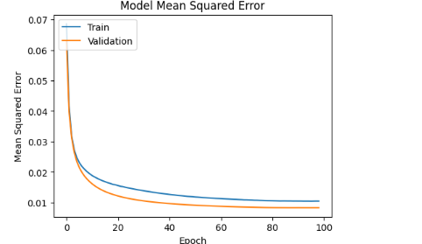
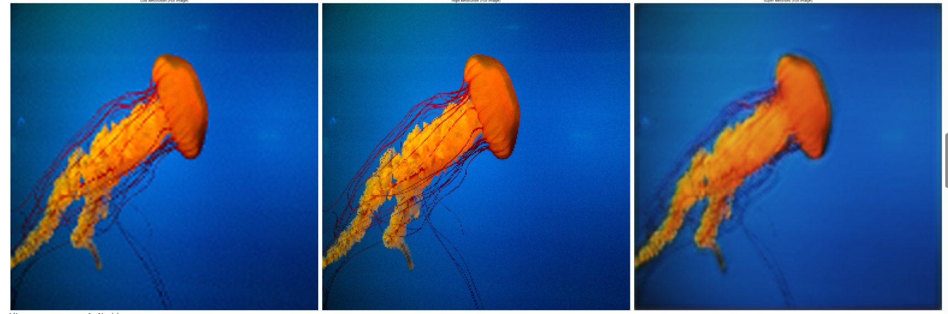
Results
Time taken (Using Colab A100 High-Ram GPU):
Ran for 99 epochs at 43 seconds each which brings us to approximately 71 minutes of training time.
The error chart shows a consistent decreasing pattern. This tells us that the model is stable and learning effectively.
low
high
super res
Notes:
Steven

Slide 9
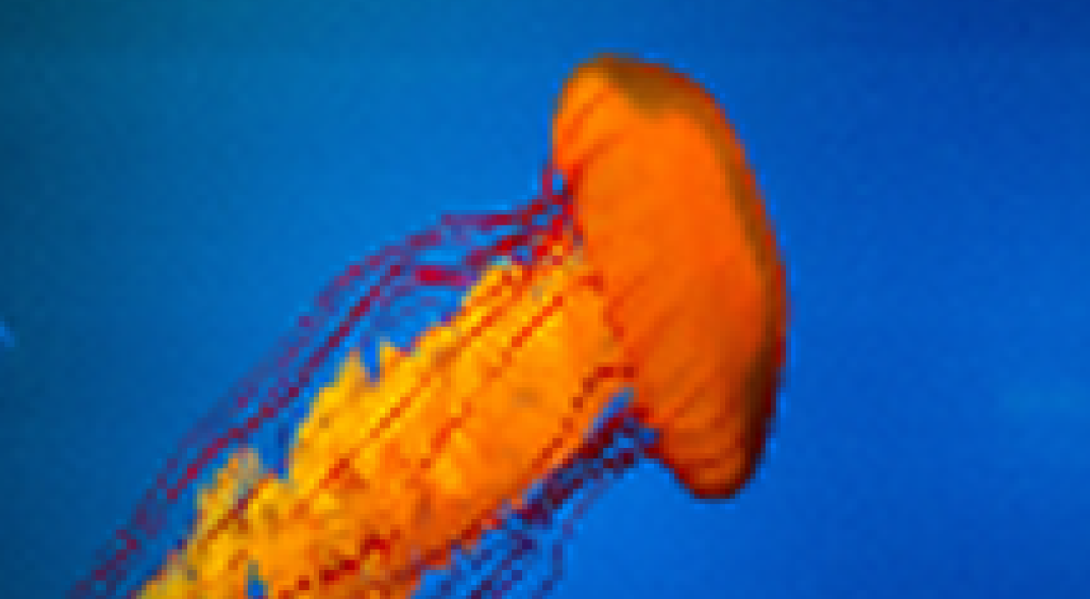
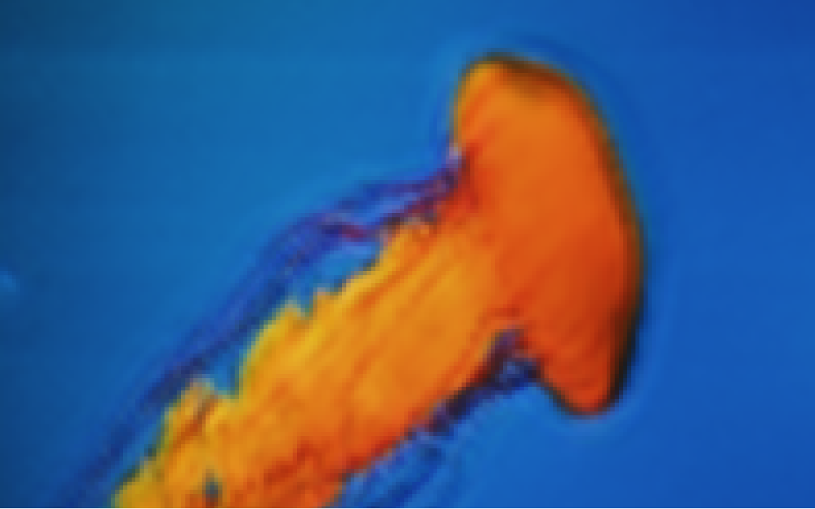
Results continued
Low res (left) vs Super res (right)
The low resolution input appears highly pixelated while the super resolved image is less pixelated and smoother, but still lacks sharp edges.
Notes:
Steven

Slide 10
Insights
While our model shows some signs of improvement to image quality, our relatively low amount of training time limits the model’s ability to produce sharper and clearer super-resolved images. It is not uncommon for models such as these to train for 12+ hours and have around 300,000 steps (compared to our 30,000 - 40,000 steps). We also could have used a significantly better more state-of-the-art architecture known as Enhanced Deep Super Resolution (EDSR) instead of SRCNN [source]
Notes:
Steven

Slide 11
Improvements
Larger Dataset:
https://www.kaggle.com/datasets/hsankesara/flickr-image-dataset
31.8k files
kB, .jpg
More Training Time:
Extending training to more steps (closer to 100,000 or even 300,000 steps)
Notes:
Chet

Slide 12
Improvements
Better Architecture:
Experiment with better architecture than SRCNN
Different Loss Function
Perceptual loss instead of MSE
Notes:
Chet

Slide 13
Conclusion
Our project demonstrates that deep learning approaches like SRCNN can effectively enhance image resolution, but they require significant computational resources and time. We have seen encouraging results but believe there is much more potential for improvement with longer training times, more data or even upgrading the architecture.
Notes:
Chet

